Slide 1
A Comparative Analysis of Different Machine Learning Models for Flight Fare Estimation Use Case
By:
MISHAL THOMAS SABU 17BCI0174
MOHIT MAYANK 17BCI0118
Project Guide: Prof. Usha K

Slide 2

AIM
Our project aims to compare publicly available data sources and evaluate different Machine Learning models for flight fare estimation use case.
The machine learning models used are random forest regression (RFR), decision tree regressor (D.T), bagging tree regressor (BTR), Gradient Boosting Regressor (GBR) and weighted combination of three regressors.

Slide 3
OBJECTIVES
Identify the unique features that affect the machine learning models to estimate flight fare.
Develop a web application to estimate and display flight fare.
Identify the machine learning model which would give good estimation of flight fare for different public datasets.

Slide 4
Motivation
Due to the highly competitive nature in today’s society a versatile skillset is highly appreciated. With this in mind showing off that one is capable of doing projects outside their specialisation allows us to standout and make us more job-ready. We students should shape our skillsets and be capable of doing projects outside our domain. Therefore, we decided to make our project on a topic that we did not specialise - in “Machine Learning” a growing powerful field.
Due to the pandemic, aviation sector is adversely affected and we decided on doing our project to evaluate the COVID effect on estimating flight fare using different ML models on publicly available data.
Any person who has booked a flight ticket realizes how the price of air ticket changes. Aviation Industry utilizes progressive techniques for fixing ticket charges based on Revenue Management strategy to develop/execute some particular algorithmic model which suits their profit margin. The price of ticket changes over the period - the expense of buying a ticket may be high or low. The techniques adopted by different airlines has inbuilt mechanism to display changes in the price based on booking days before the flight journey day, fuel price fluctuations, holiday season, time like morning, evening or night etc. Cost may sometimes change with the seasons like winter, summer or festivity seasons. The objective of the airlines is to maximise its earnings from flight charges yet on the contrary, buyer is looking to get the ticket at an affordable price which is not expensive. Buyers by and large try to buy the ticket ahead of the departure day. Since airfare will be in all likelihood to rise when the date of purchasing the ticket is nearer to the departure date, yet it isn't for the most part obvious.

Slide 5
RELATED WORKS
Study of Aviation Sector
Study of publicly available datasets
Review of research papers related to flight fare
Identification of ML models
Efficiency and reliability to estimate
Python Coding in Kaggle
Webapp development in Flask

Slide 6
Literature Review
INDEX | RESEARCH PAPER | ABOUT | ADVANTAGES | DISADVANTAGES
1 | Random Forests [1] | Article details about the concept of random forests, a statistical tool which is a combination of tree predictors in which each tree depends on the values of random vector sampled independently and with same distribution for all trees in the forest. Each Tree classifier depends on the individual tree in the forest and correlation between them. By combining trees to form a forest by considering the random features gives improved accuracy to the model. Random forests for regression is achieved by binding the mean squared generalization error which is derived from the correlation between residuals and the mean squared error of the predictor trees. Random split selection Forest, bagging random forest, introduction of random noise into the outputs for lowering generalization error. When randomly selected features are used to split each node, resultant rate of errors can be compared to that of Adaboost as boosting is believed to be a special case of random forests. | Random Forests accuracy is as good as Adaboost and sometimes even better. It is relatively robust to outliers and noise. It is faster than bagging or boosting. It can be used of classification and regression problems It's simple and easily parallelized. | Random forest is a black box like approach for a statistical modelers they have very little control on what the model does For regression problems it cannot predict beyond the range in the training data
2 | Airfare prices prediction using machine learning techniques [2] | The article is attempting to predict the air fare in Greece by investigating the features which influence or affect the airfare. The articles gave detailed brief about the four phases of the study such, selection of features that influenced the airfare, the flight data collection to train and test the ML models, comparison of various ML Models and finally the evaluation of the experimental models. The article goes on to compare the accuracy of models when using various features to determine the important factors when predicting airfare. | We are able to see how various features affect airfare. | Only certain features are being considered and the others are not being taken into account 1817 data entries are being used to train and validate the models. Which does not seem like enough data to create valid models

Slide 7
INDEX | RESEARCH PAPER | ABOUT | ADVANTAGES | DISADVANTAGES
3 | An Airfare Prediction Model for Developing Markets [3] | The research paper focused on Vietnam aviation scene to evaluate the features that have significant impact on airfare fluctuations. Predictions based on developed countries aviation industry is not sensitive in giving a precise prediction model which is relevant to developing countries. The data was collected from 21 days prior to departure. To understand the airfare variation over the days, the price feature was used to create two additional features like fluctuation index and fluctuation amount. The graph plotting these additional new features till the departure date gave insight about the airfare price variations. The Random Forest model and Multilayer Perceptron were combined with the use of weights to improve accuracy. | We see how well different models accurately predict airfare. We see that there is a significant increase in accuracy when using weights to combine the Random Forest model and Multilayer Perceptron model. | Only Two models are combined to improve accuracy. We do not know the effects of combining others. Data is gathered only 21 days prior to departure.
4 | Predicting the Price of a Flight Ticket with The Use of Machine Learning Algorithms [4] | The research paper aims to identify the price of a ticket given a day based on the data collected from makemytrip.com for the first quarter of 2011 for flights from Bombay to Delhi. This data is fed to variety of machine learning models, like KNN, SVM, Decision tree, to predict the price. After predicting the prices, the values are compared with the actual value and is plotted on a graph based on number of days before departure. This graph is used to study the trend of price with respect to days before departure. | The trend of price is visualized. It predicts price based on readily available data. | The data of the first quarter of 2011 is only being used to predict price. Other Important features like bulk fare and passenger count are not taken into account.
5 | Airline ticket price and demand prediction: A survey [5] | It is a research paper that is a comprehensive study on existing works. It describes ticket pricing as dynamic and separates the existing models into customer side, uses restricted features extracted from historical data, and airline side model which uses limited internal factors like seat availability, fare class, recent demand etc. It also discusses the strength and weakness of existing works like performance issues and dataset issues. It also suggests using social media-based data to improve ticket price and demand prediction. | Clearly summarizes the existing works. Suggests direction for future improvements | Does not talk about models that are a mix of airline side models and customer side model Is a theoretical work.

Slide 8
INDEX | RESEARCH PAPER | ABOUT | ADVANTAGES | DISADVANTAGES
6 | To buy or not to buy: mining airfare data to minimize ticket purchase price [6] | This research paper deals with predicting the optimal time to buy tickets for cheap prices. They used models like Hamlet, Q learning, Ripper, Time Series to test its workings. The result of the various tests was that Hamlet was robust and outperformed the other models. | It was able predict prices and tell whether to buy the ticket now or wait the price will decrease. | The data used only spanned 21 days in advance. The entries were all from January 2003
7 | Creating a prediction model of passenger preference between low cost and legacy airlines [7] | This research paper deals with predicting passenger preference between low cost and legacy airlines. The data was collected using Mturk. From the study 4 factors were found to be significant predictors out of the 9 factors. They were frequency of travel in a year, income of the participant, seat type and education level of the participant. The study was divided into 2 stages. Stage 1 was regression analysis. Stage 2 to validate the results from stage 1. | It allows for people’s preferences to be determined easily. This type of study allows flight finders to readily give acceptable suggestions to its users. | For more accurate predictions sensitive information has to be disclosed. The data was gathered from MTurk and therefore is likely to be biased.
8 | Design and implementation of ticket price forecasting system [8] | This article uses Random Forest model in combination with ARMA model to predict air ticket prices. The data was collected up to 60 days in advance to departure in 12-hour intervals. The data collected was city of departure, destination, ticket purchase date, departure date, ticket options with the price, time of departure. It uses the model in an system to predict airfare. The system consists of 3 layers. It has view layer as its interface, Functional layer where the forecasting and data management occurs and the data layer is the layer where flight data is stored | From the paper we see that the combined model gives better accuracy than standalone models. | Contains data from 60 days in advance. Does not how accurate the models are. The System implementation is not explained but rather represented as abstract parts in a diagram.

Slide 9
INDEX | RESEARCH PAPER | ABOUT | ADVANTAGES | DISADVANTAGES
9 | A Framework for Airfare Price Prediction: A Machine Learning Approach [9] | In this Research paper the datasets used to predict flight fare are publicly available Datasets the DB1B and the T-100 datasets that are collected and maintained by the Office of Airline Information within the United States Bureau of Transportation Statistics (BTS). This data in combination with macroeconomic data is used to predict the quarterly average airfare at the market segment level. Models like LR, SVM, MLP, XGBoost and Random Forest were used to predict the price. Random Forest was found to predict the price 80% accuracy. | Shows us that we can predict airfare using market level segment data. Describes the important factors to predict airfare | Does not tell us of which particular years data was used. The destination and origin of flight is not considered in predicting price.
10 | ACER: An Adaptive Context-Aware Ensemble Regression Model for Airfare Price Prediction [10] | This research paper proposes a context-aware ensemble regression model called ACER which is a combination of different context-aware models and it adjusts context features adaptively. It is a framework that can train base learners with context-aware data and combine multiple base learners to overcome the shortage of a single base learner. The experimental data is collected from one of the leading Online Travel Agencies (OTAs) in China. The were scored based on MAPE. It was shown to out perform a lot of base models like Random Forest, KNN and Bayesian. | ACER finds features which are suited as context information so that context-aware models can be trained. | Does not detail about the data source. Does not R2 score. Large RAM required for training.

Slide 10
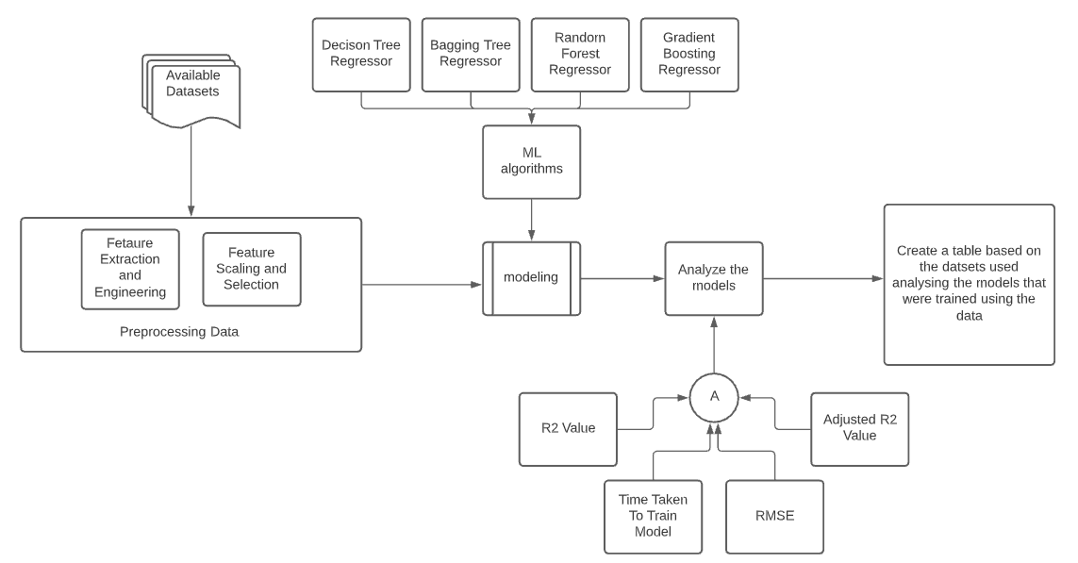
Proposed System
Dataset Analysis workflow

Slide 11
Proposed System (contd.)
Flights are an important mode of transportation in our present society. Today the flight prices depend on a variety of factors and changes on an hourly basis. Our project deals with comparing publicly available datasets and evaluates various models commonly used for flight fare estimation.
With the use of machine learning models like random forest, decision trees and bagging regressor we aim to build a model that can estimate airfare price. In this project we measure the model scores based on the R2 score, RMSE value and time taken to train the model as well as to analyze the relation between various attributes that can influence flight price with the help of a publicly available datasets. To get a good model we aim to combine different models by assigning weights to get better results. Using the best model, we aim to build a flight price predictor webapp using python flask.

Slide 12
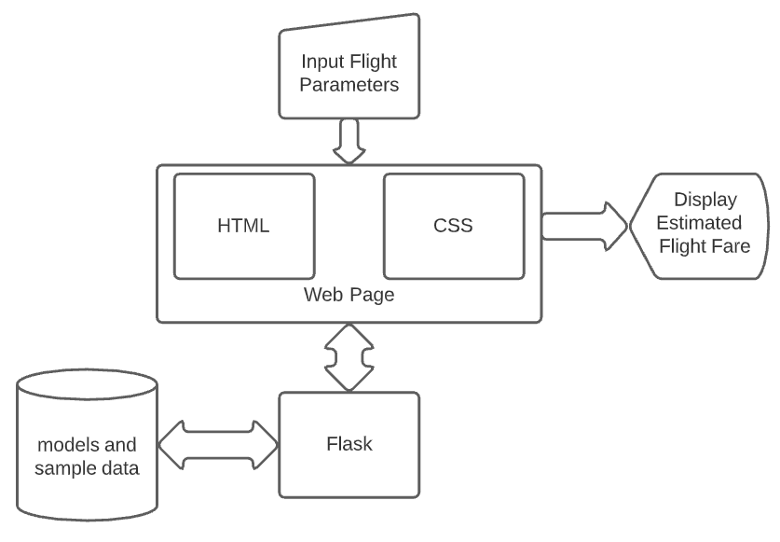
Proposed System (contd.)
Flight Fare Estimator Web Application Architecture Diagram

Slide 13
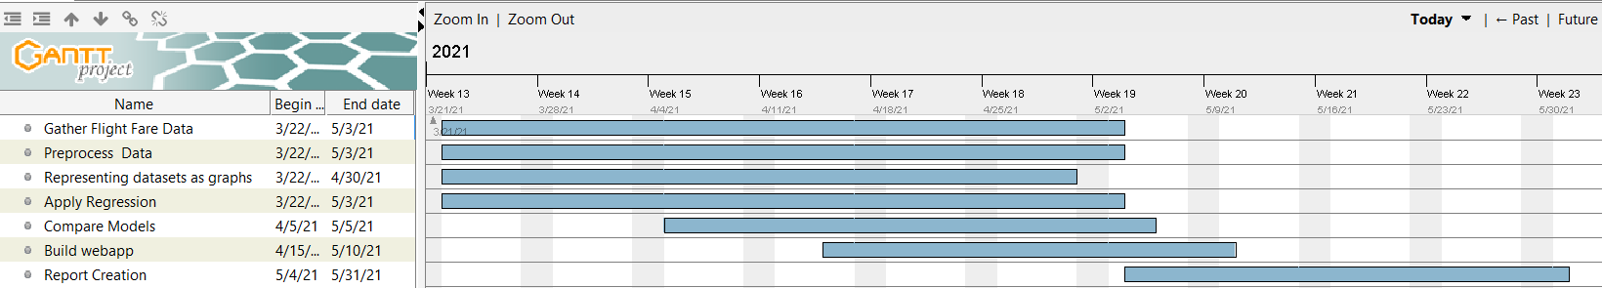
SCHEDULE TASKS AND MILESTONES

Slide 14
The tasks are:
Gather data from various sources Start date: 22 March 2021 End Date: 3 May 2021
Process the gathered Data Start date: 22 March 2021 End Date: 3 May 2021
Understanding the data Start date: 22 March 2021 End Date: 3 May 2021
Applying the regression Start date: 22 March 2021 End Date: 3 May 2021
Comparison of models Start date: 22 March 2021 End Date: 3 May 2021
Web application building Start date: 15 April 2021 End Date: 10 May 2021
Report Creation Start date: 4 May 2021 End Date: 31 May 2021
The milestones for the project are:
Creation of the summary table which contains the model evaluation results for each dataset used.
Creation of Webapp using flask to predict flight fare

Slide 15
PROJECT DEMONSTRATION
The datasets used are:
DB1B Dataset
A Kaggle dataset that contains data from Ease-My-Trip
A Dataset from the Machine Hack Hackathon to predict flight fare.

Slide 16
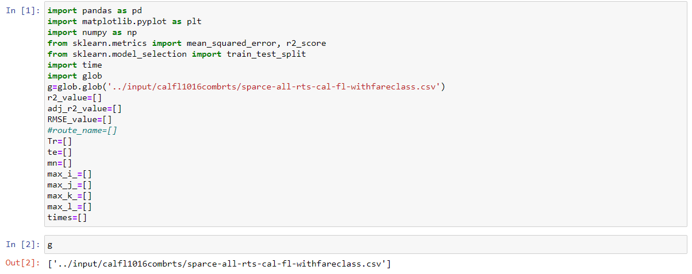
DB1B Dataset: Normal view:

Slide 17
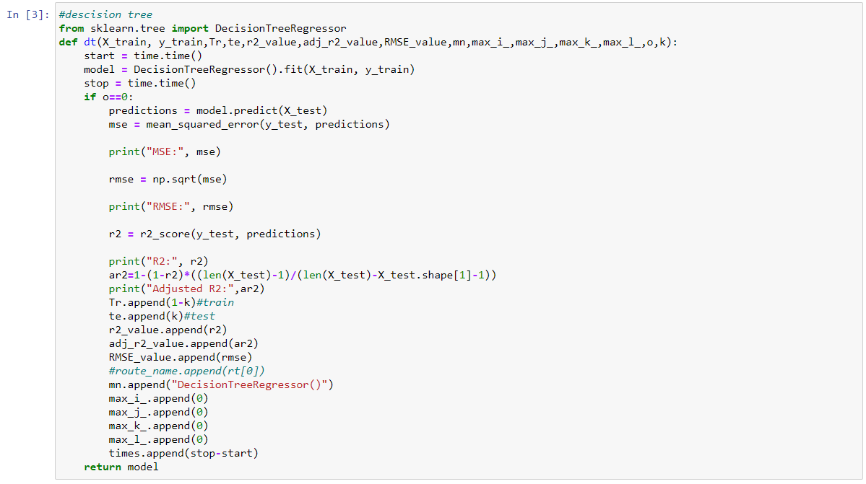

Slide 18
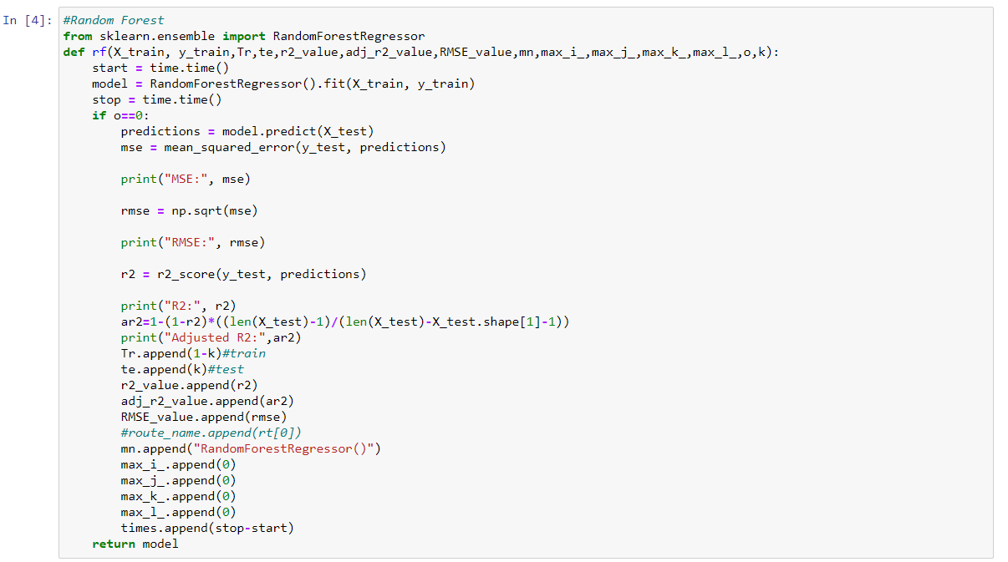

Slide 19
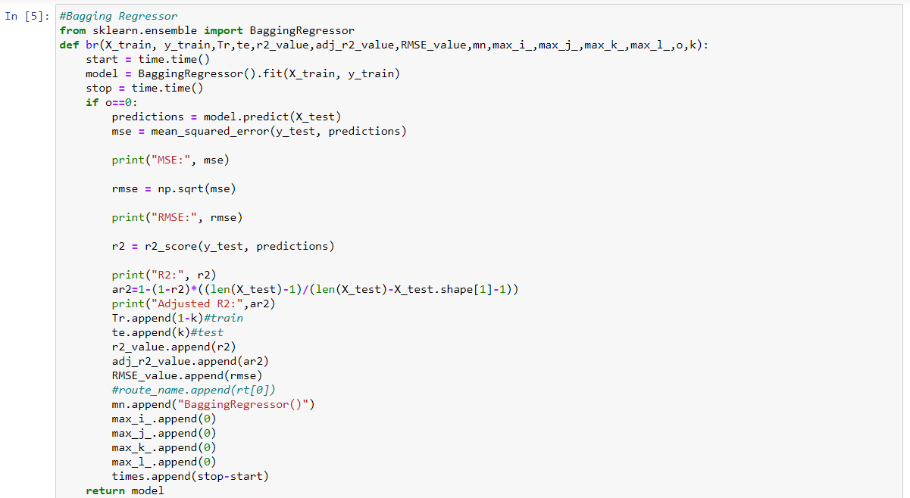

Slide 20
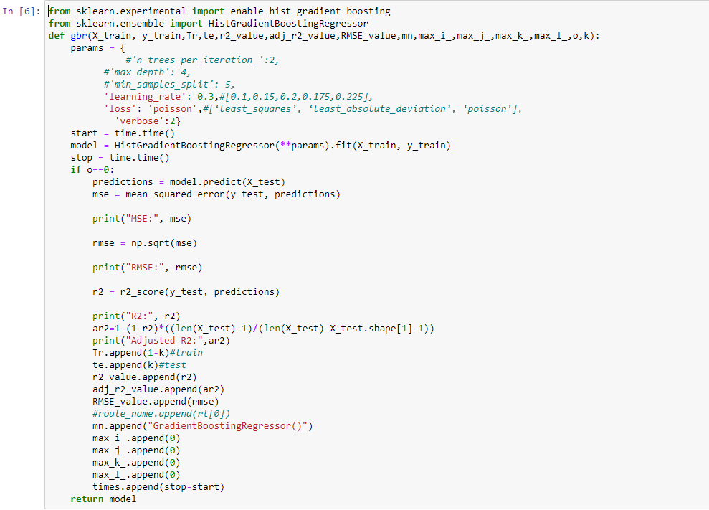

Slide 21
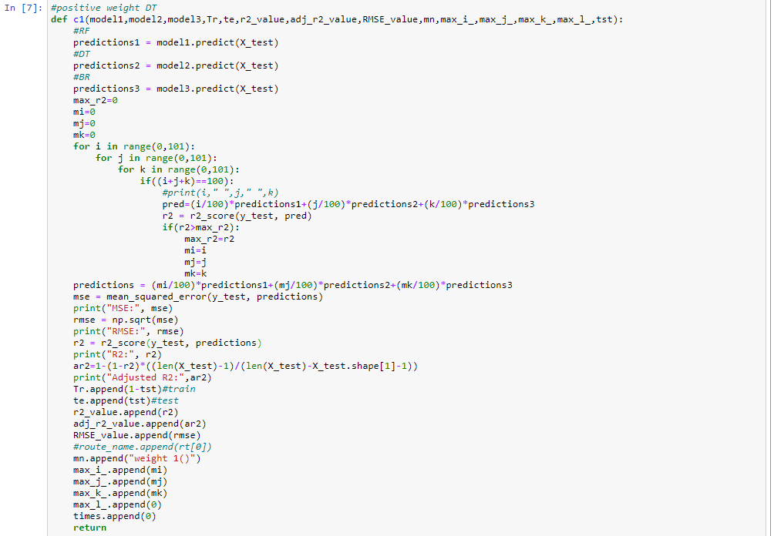

Slide 22
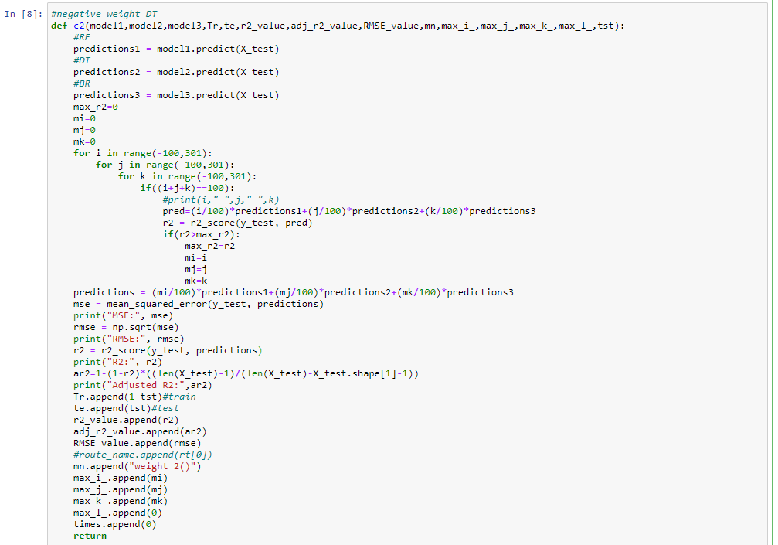

Slide 23
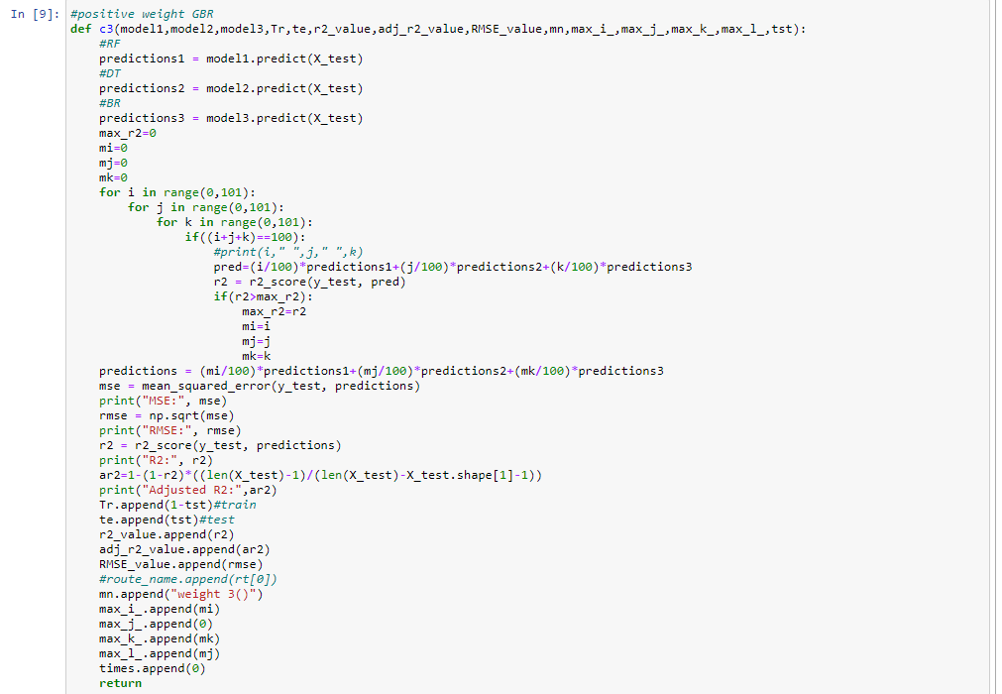

Slide 24
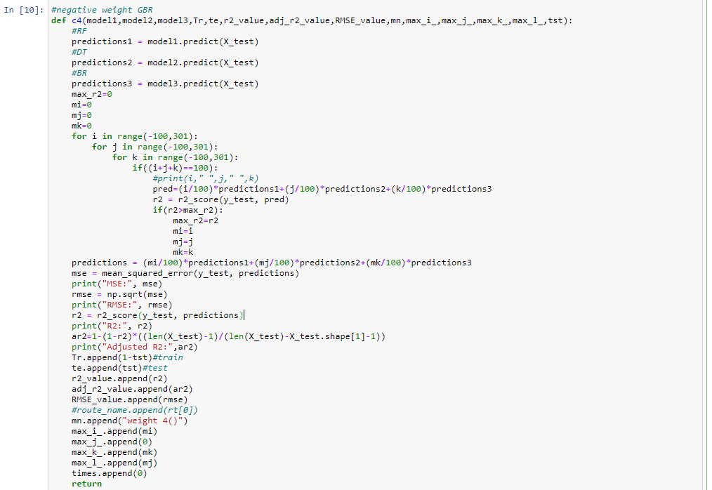

Slide 25
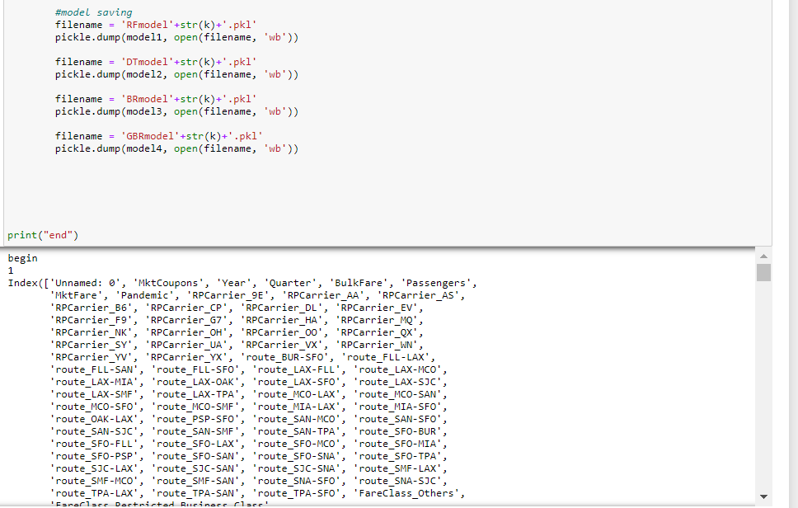

Slide 26
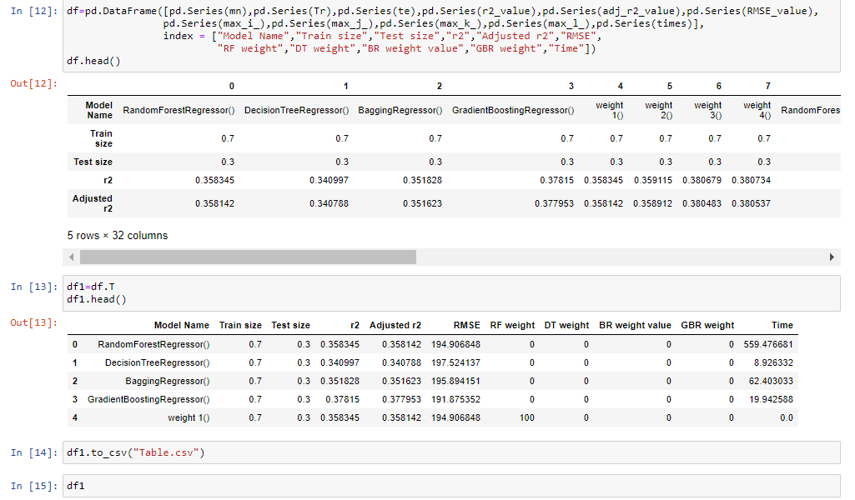

Slide 27
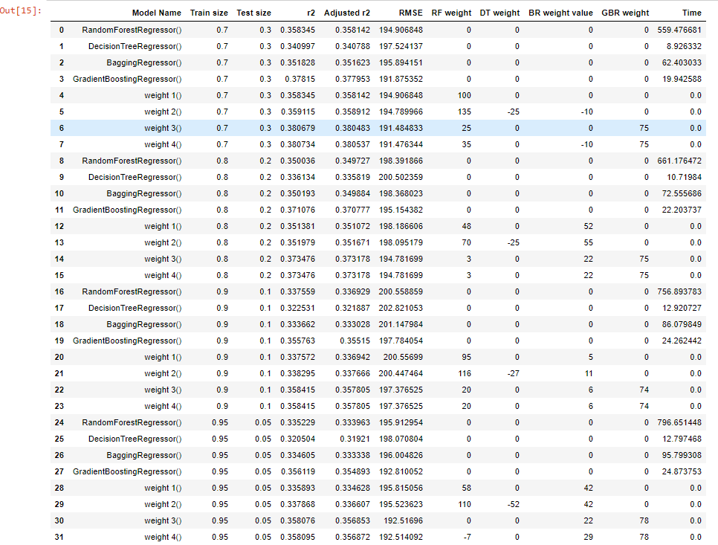

Slide 28
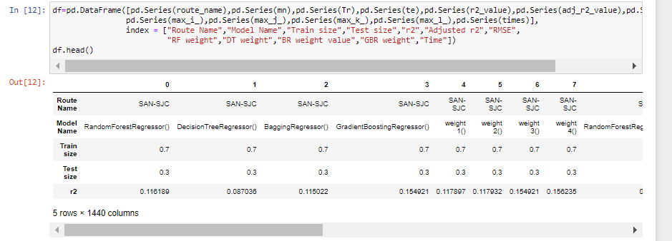
Sub-route view:

Slide 29
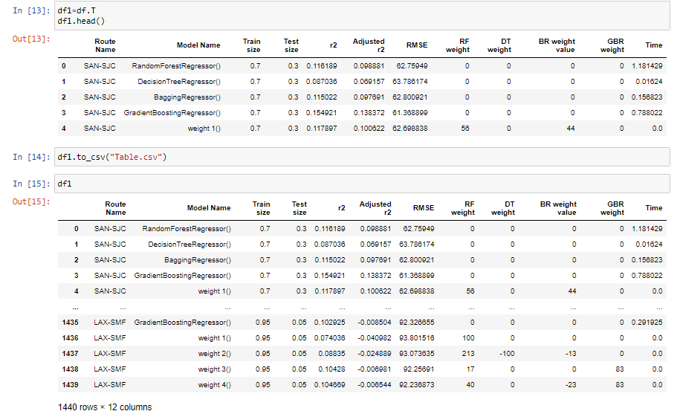

Slide 30
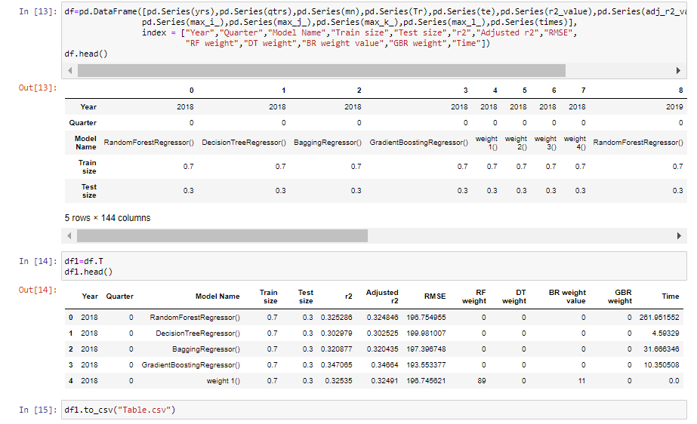
Normal view divided into years and quarters:

Slide 31
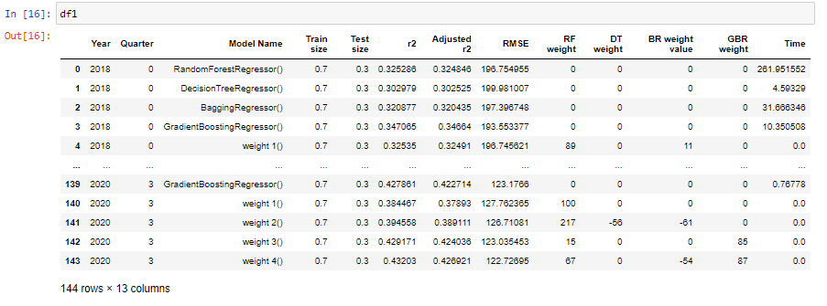

Slide 32
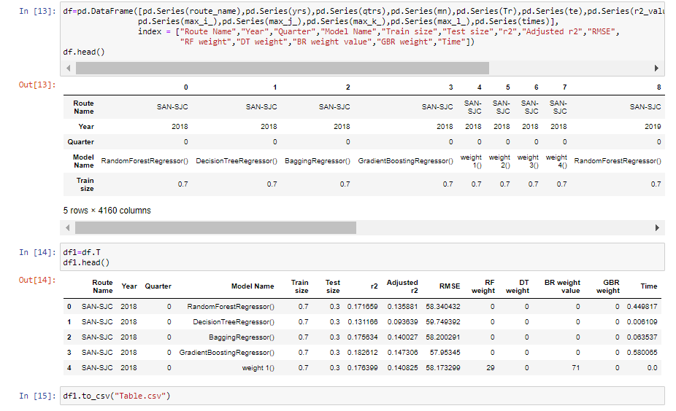
Sub-route view divided into years and quarters:

Slide 33
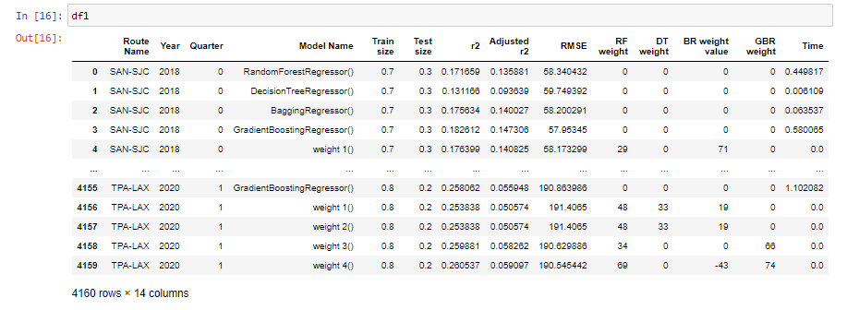

Slide 34
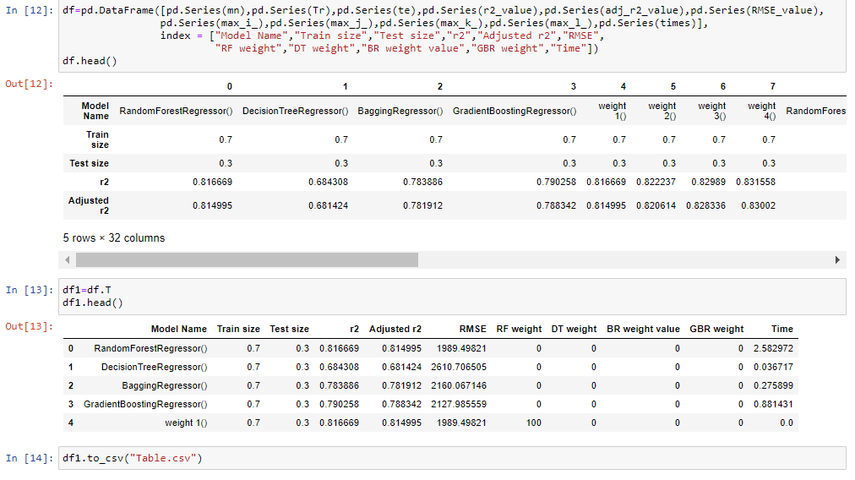
Machine-Hack Dataset:

Slide 35
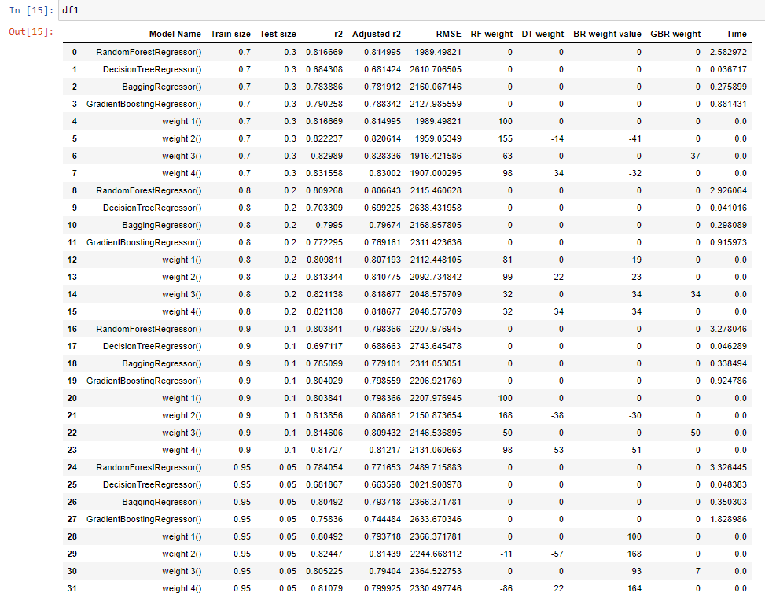

Slide 36
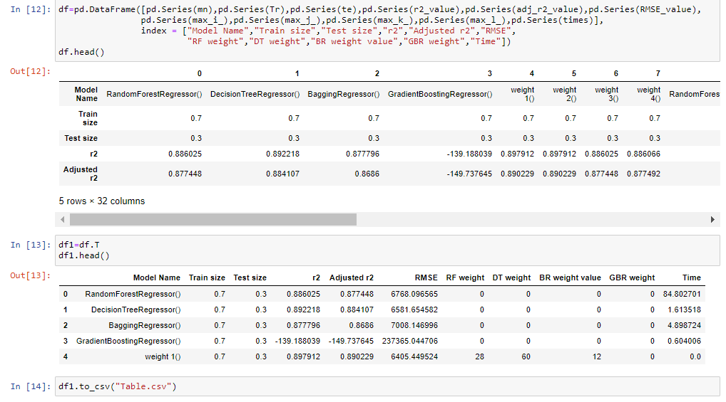
Ease-My-Trip Dataset:

Slide 37
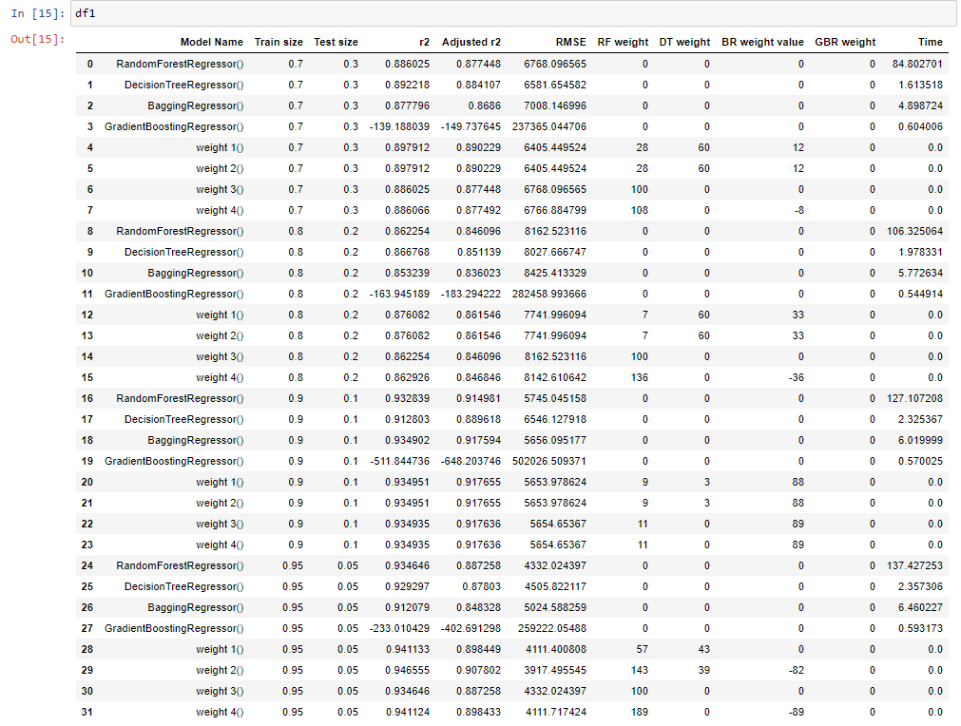

Slide 38
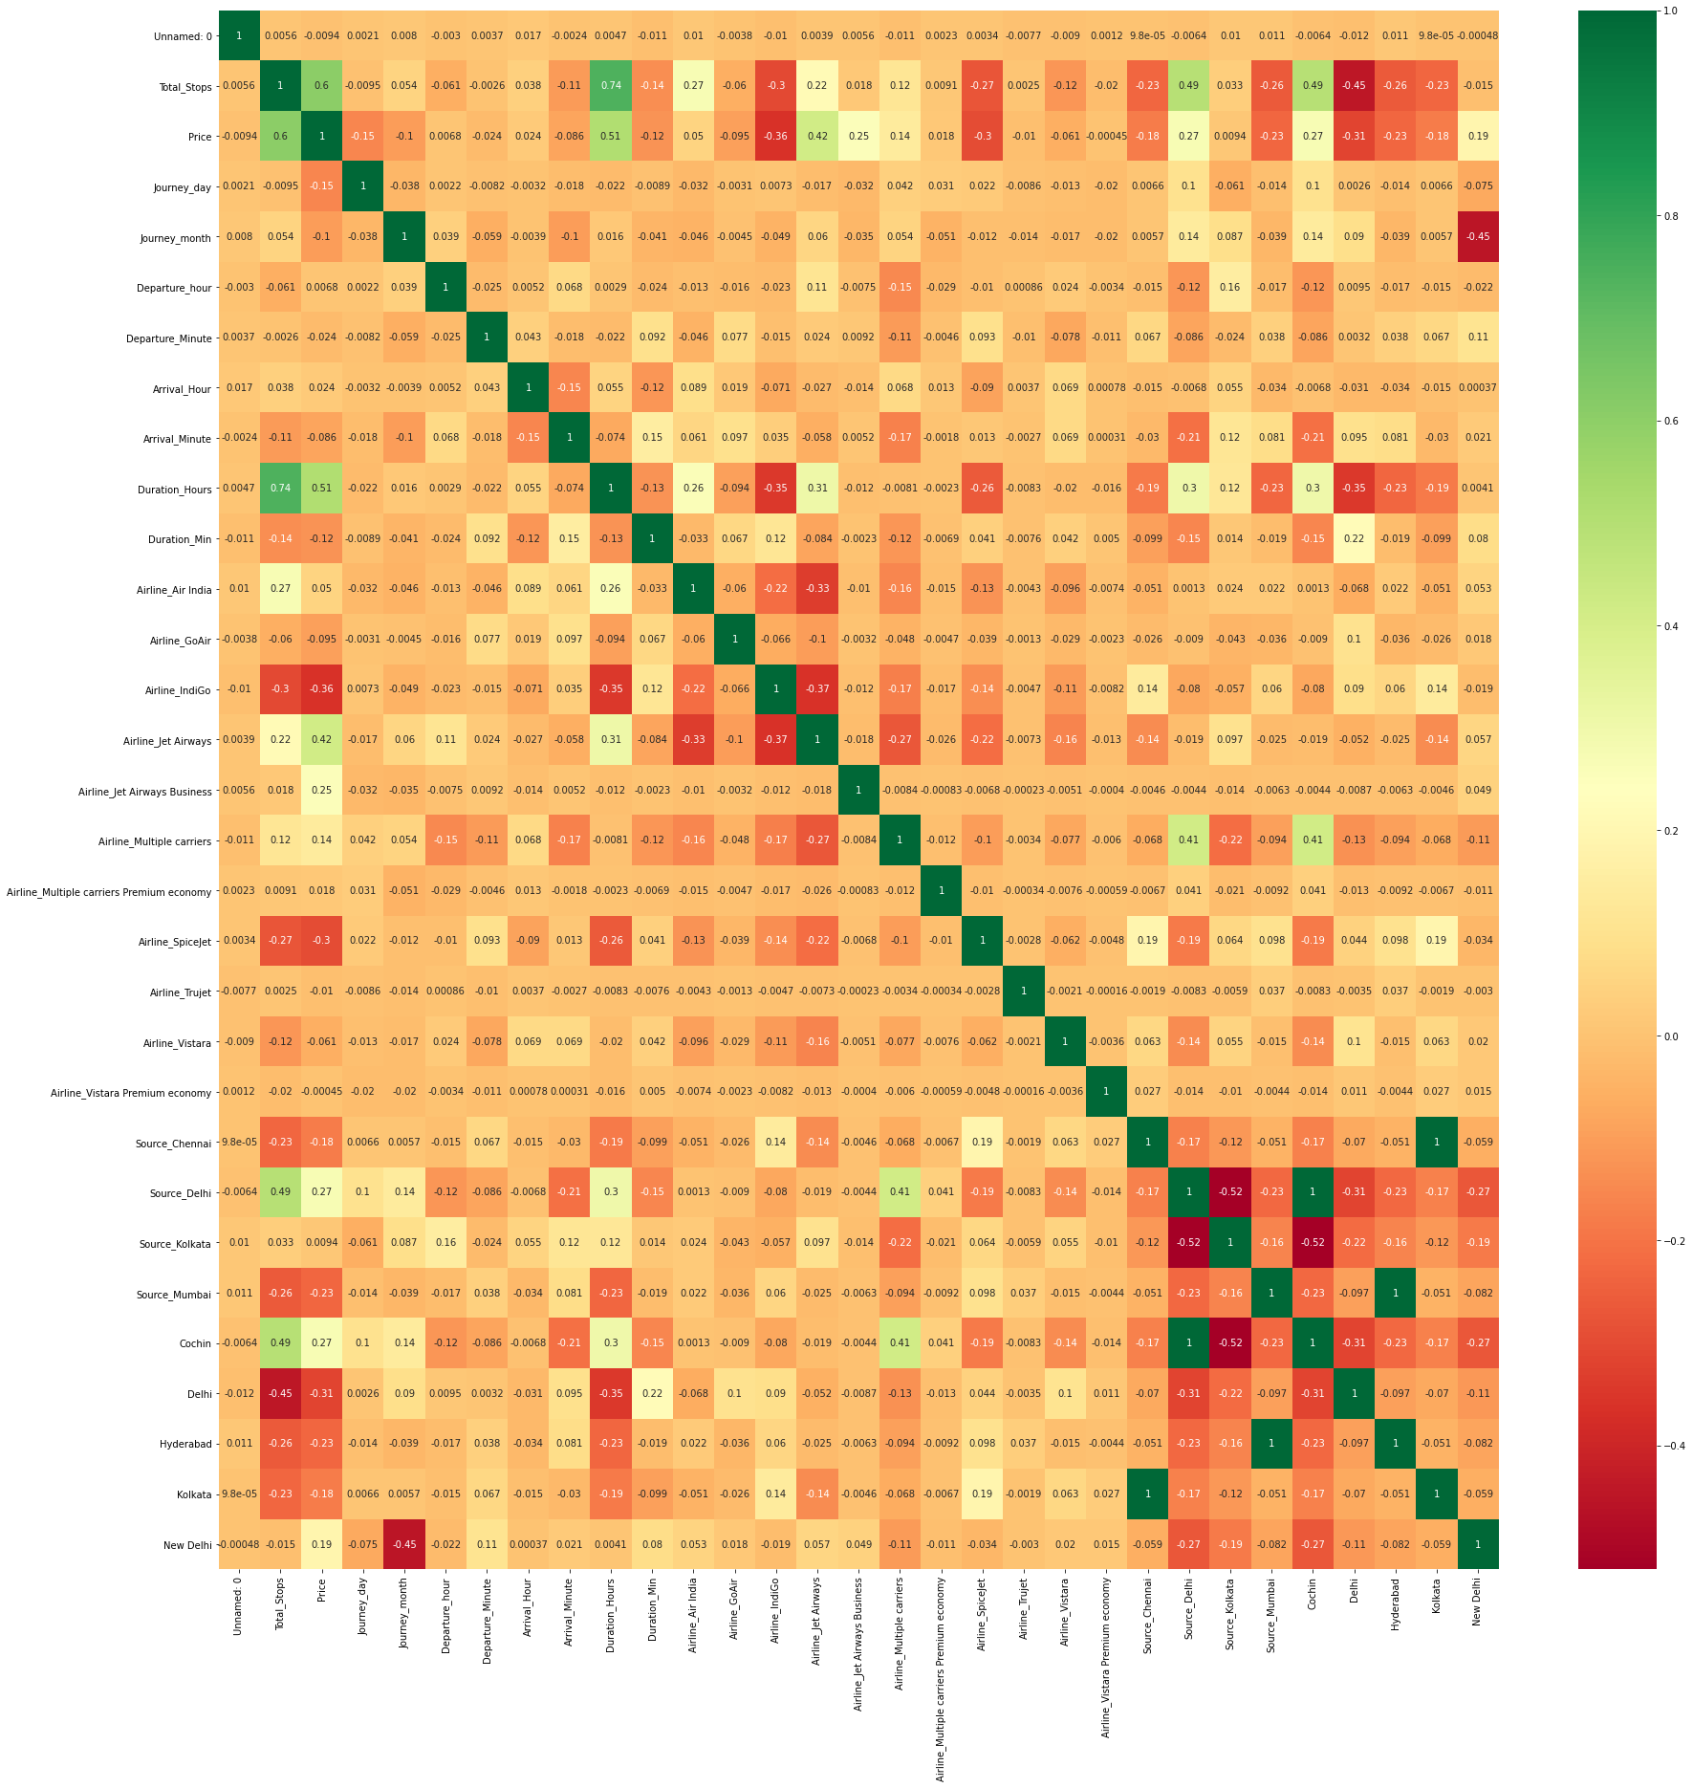
Heat-Map (Machine Hack Dataset)

Slide 39




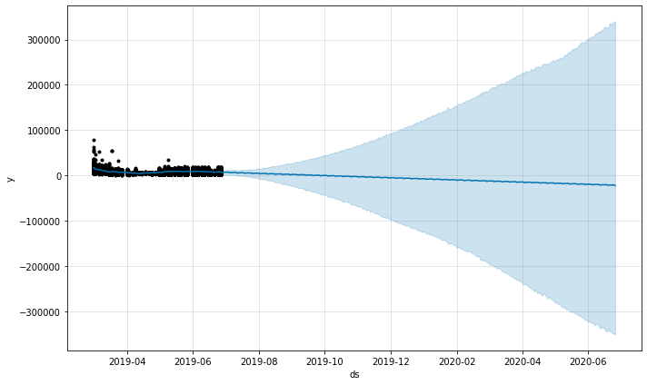
Forecasting (Ease-My-Trip Dataset)

Slide 40
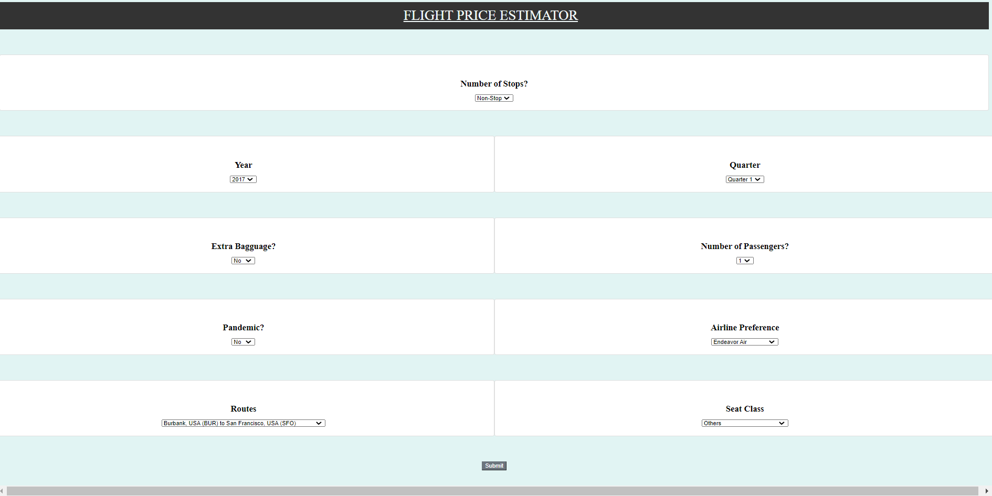
WEB APPLICATION

Slide 41
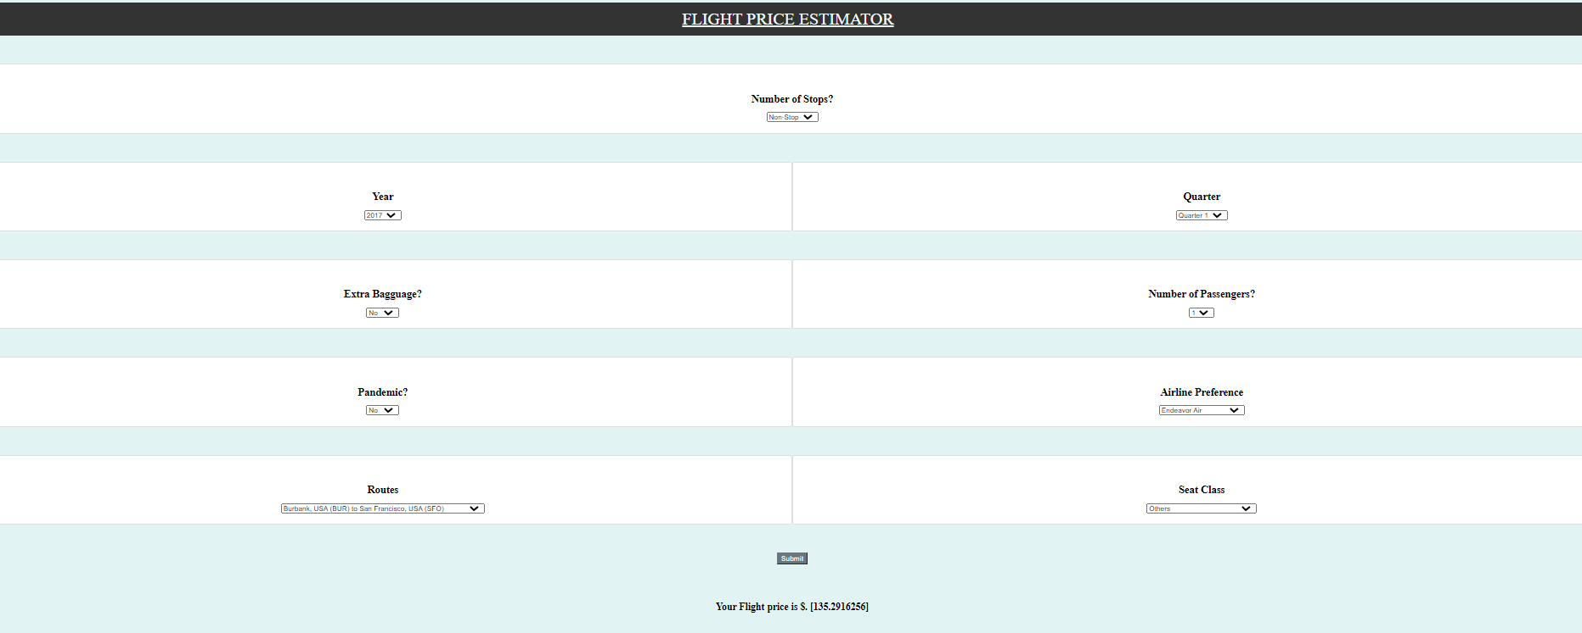

Slide 42
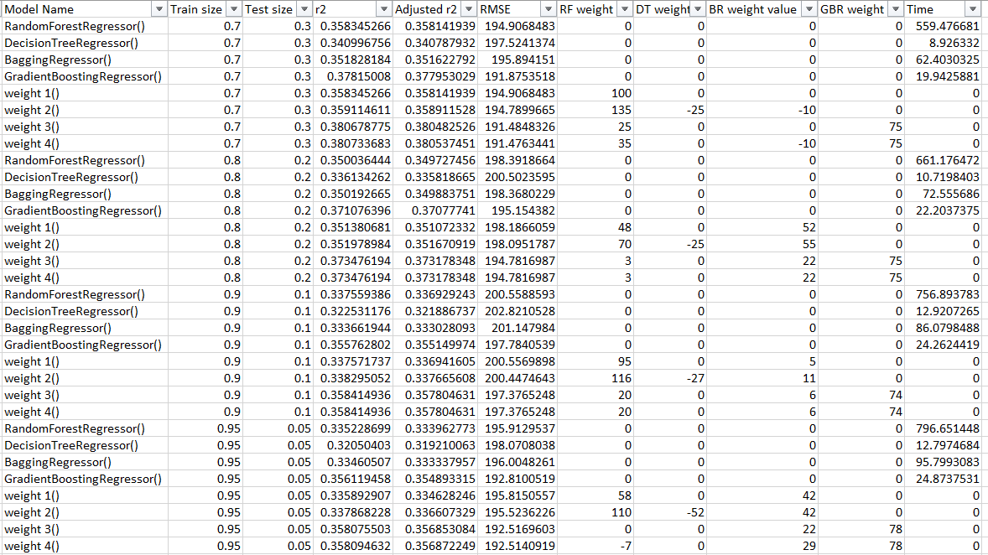
RESULT AND DISCUSSION When looking at the DB1B dataset under normal view: Table 8.1: DB1B dataset Normal View

Slide 43
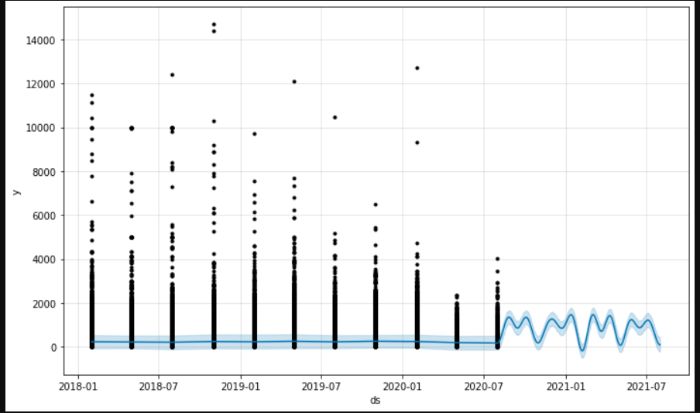
The time taken for training follows the order DT<GBR<BTR<RFR The R squared value follows the trend: weight4>= weight3>= weight2>= weight1>GBR>RF>BR>DT With an increase in training size, we see a decrease in the R-Squared value. The order of priority for weights in the combined model seems to be GBR>RF>BTR>DT The R2 value range is 0.3205- 0.3807 Fig 8.1: Prophet DB1B Dataset normal view

Slide 44
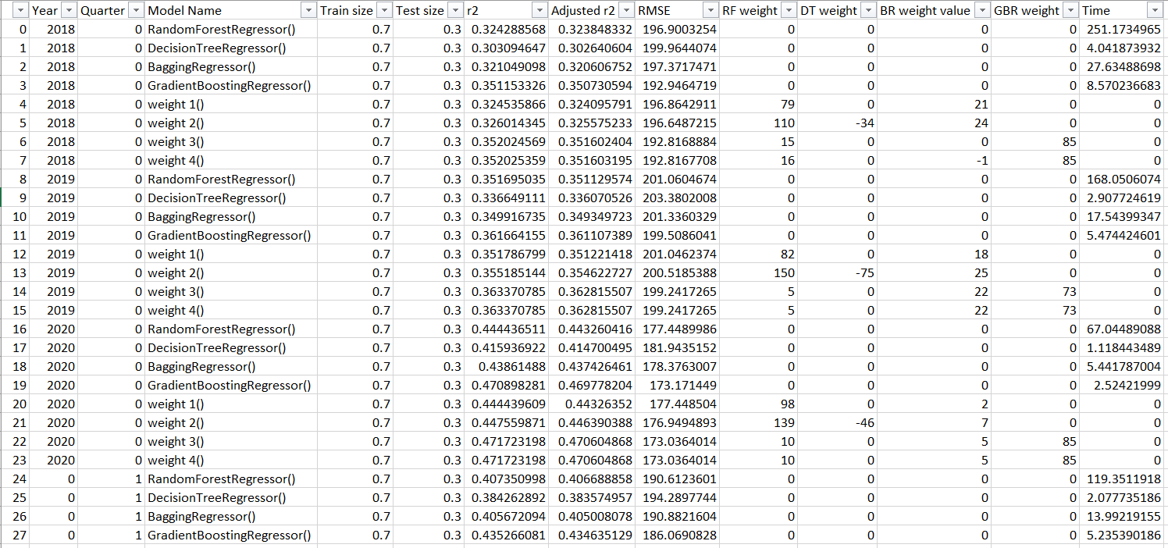
When using Facebook’s Prophet algorithm, which is used to predict using time series data, to understand the trend in the DB1B dataset Normal view see a pattern of rise and falls but the scale at which this occurs is larger than inputted value’s scale which is likely a result of outliers. When the DB1B dataset normal view is split based on years and quarters we get the table 8.2 Table 8.2: DB1B Dataset Normal divided into years and quarters

Slide 45
The time taken for training follows the order DT<GBR<BTR<RFR The R squared value follows the trend: weight4>= weight3>weight2>= weight1>GBR>RF>BR>DT With an increase in training size, we see a decrease in the R-Squared value. The order of priority for weights in the combined model seems to be GBR>RF>=BTR>DT The R2 value range is 0.2506- 0.4717 Since an increase was made when the data was divided into years and quarters. Dividing the normal Dataset into sub-routes result in Table 8.3

Slide 46
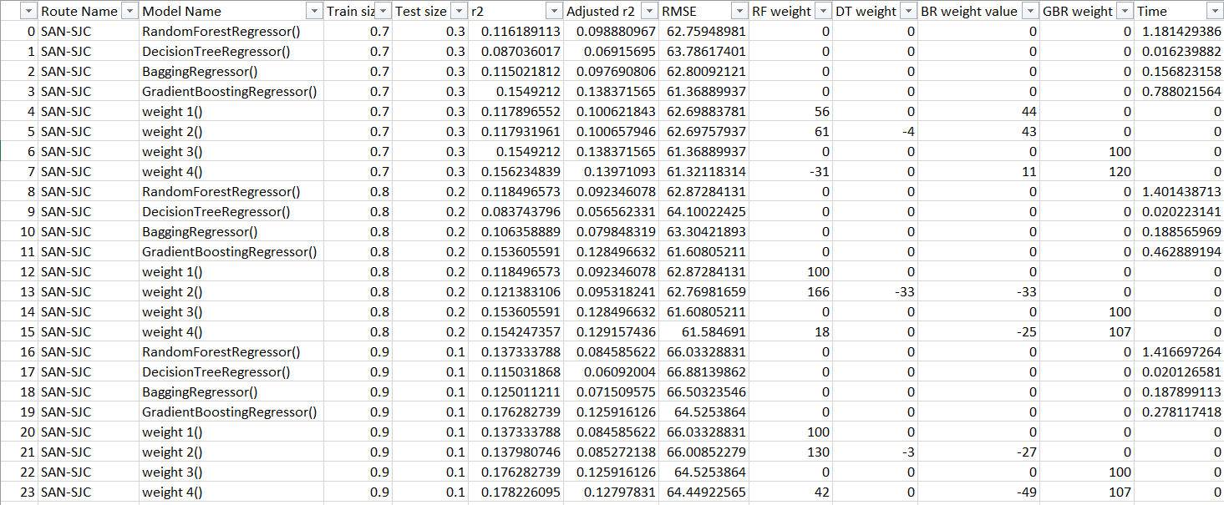
Table 8.3: DB1B Dataset Sub-route View

Slide 47
The time taken for training follows the order DT <BTR<GBR <RFR
The R squared value follows the trend:
weight4>= weight3>weight2>= weight1>GBR>RF>BR>DT
Depending on the sub-route in question, an increase in training size causes a decrease in the R-Squared value. Whereas in some cases R-Squared value increases.
The order of priority for weights in the combined model seems to be
GBR>RF>=BTR>DT
The R2 value range is -3.0511- 0.5612
When looking at Facebook’s prophet’s prediction for each various routes in images 7.2-4 we see that the expected trends are drastically magnified likely due the outlier distribution. Though the trends maybe magnified we are able to see how the price is expected to change with time.

Slide 48
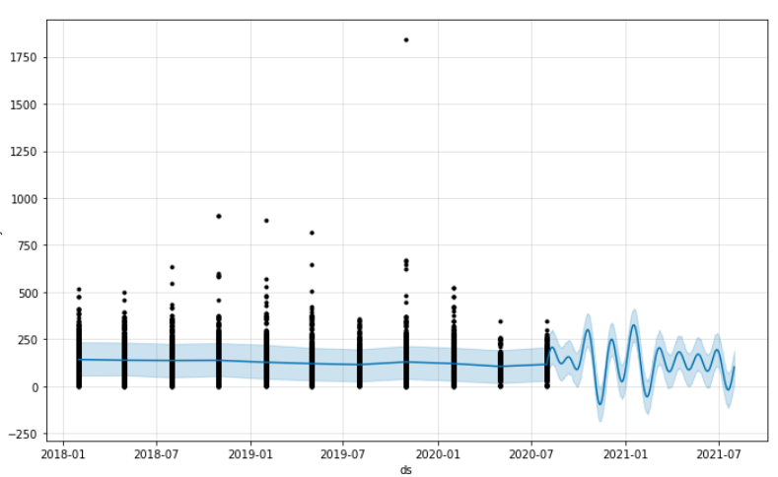
Fig 8.2: Prophet BUR-SFO Route

Slide 49
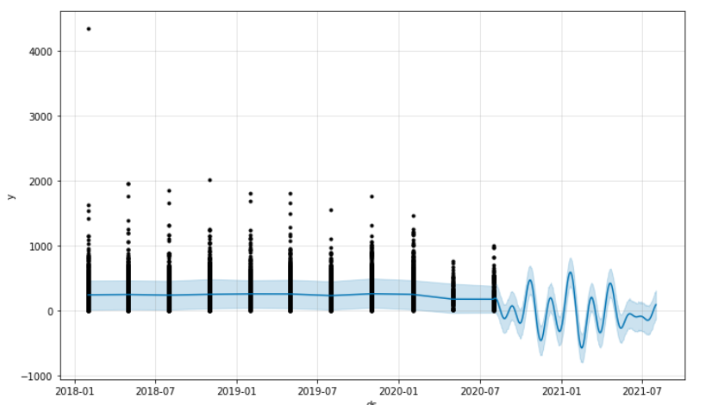
Fig 8.3: Prophet FLL-LAX Route

Slide 50
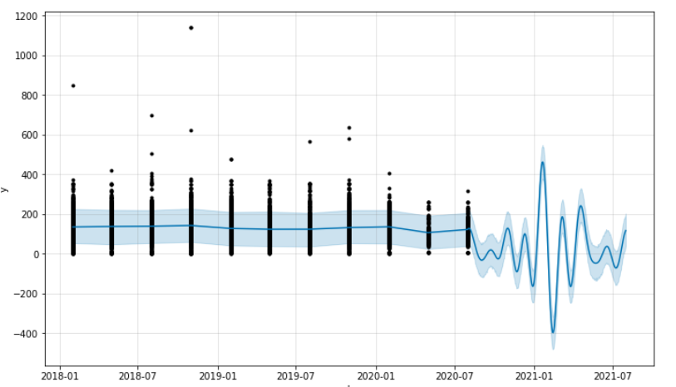
Fig 8.4: Prophet LAX- FLL Route
Sub-Routes are divided based on years and quarters to see the effects of a time period has.

Slide 51
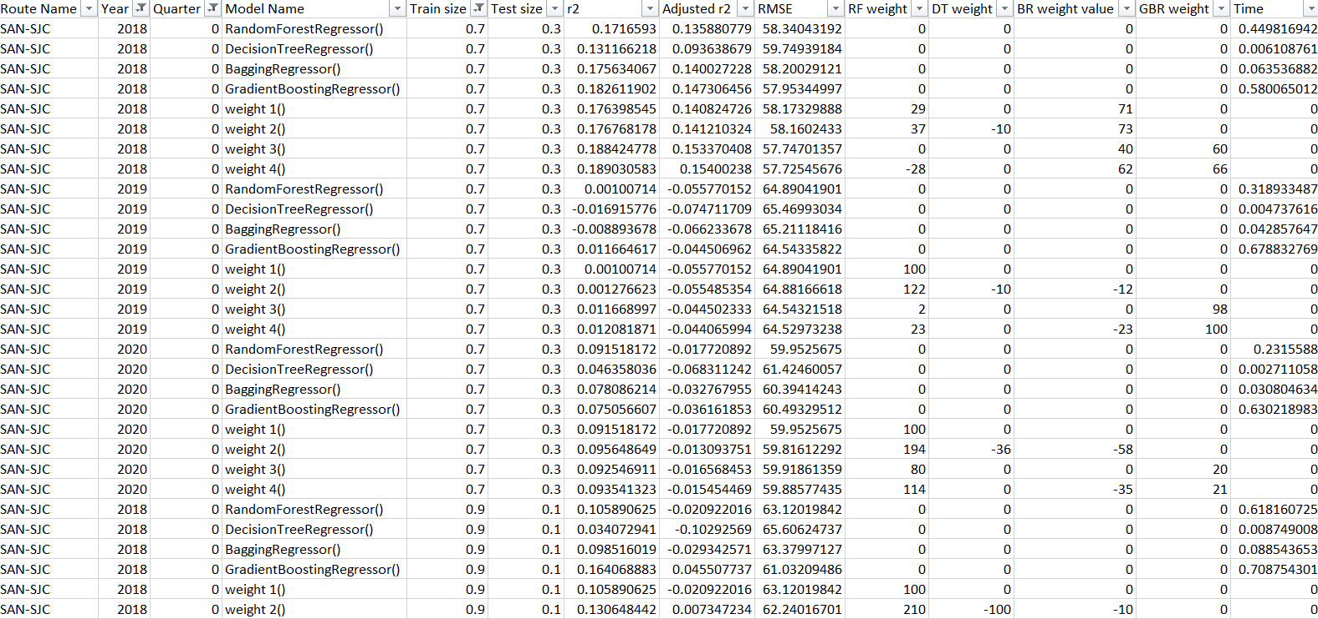
Table 8.4: DB1B Dataset Sub-route View divided based on years and quarters

Slide 52
The time taken for training follows the order DT <BTR <RFR<GBR The general R squared value follows the trend: weight4>= weight3>weight2>= weight1>GBR>RF>BR>DT The order of priority for weights in the combined model seems to be GBR>RF>BTR>DT The R2 value range is -5.0394- 0.6640 We see that by splitting the data based on year and quarter can increase the R2 value. The value of the R2 now not only depends on quality of the data for that specific quarter and year. Though it is likely to increase R2 value by increasing training size up to a certain extent.

Slide 53
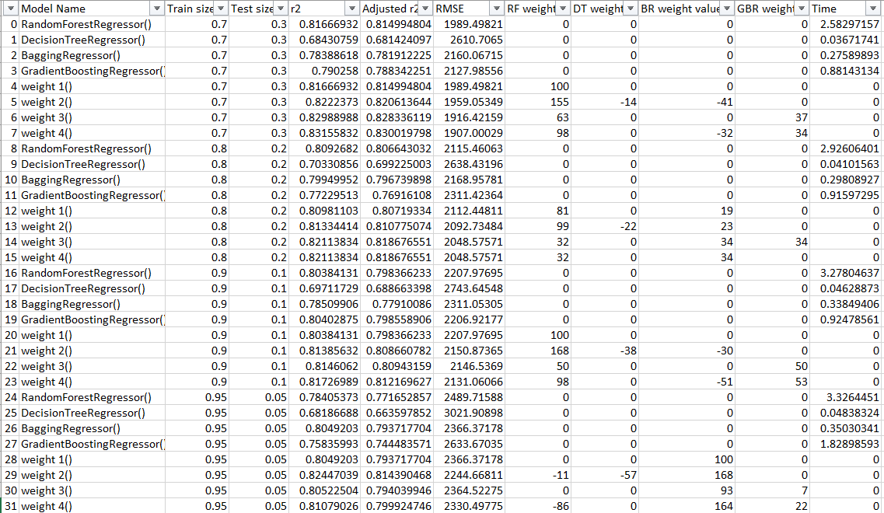
Table 8.5: Machine Hack Dataset model summary table

Slide 54
The time taken for training follows the order DT <GBR <BTR <RFR
The general R squared value follows the trend:
weight4>= weight3>weight2>= weight1> RF >GBR>BR>DT
The order of priority for weights in the combined model seems to be
RF>BTR>= GBR>DT
The R2 value range is 0.6818- 0.8315
We observe the GBR is worsening when compared to DB1B dataset this can be due to decrease in number of columns present in the dataset.

Slide 55
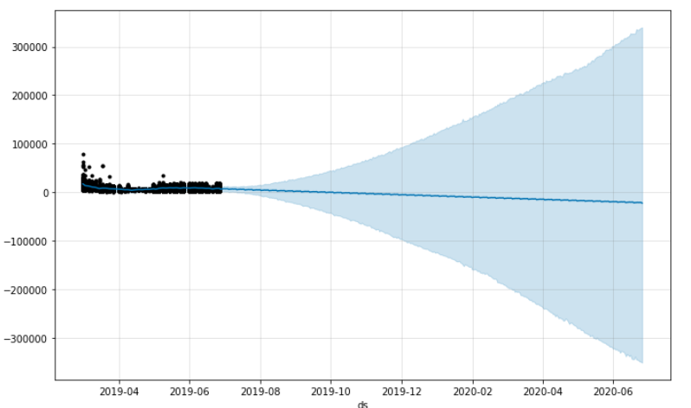
Fig 8.5: Prophet’s – Machine Hack Dataset

Slide 56
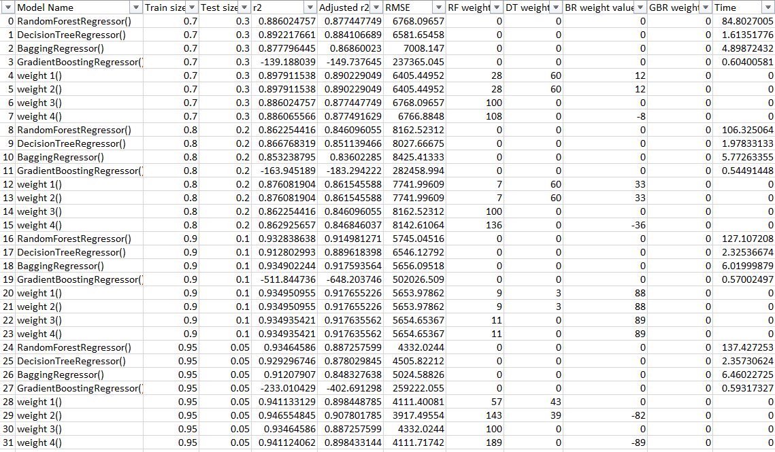
Based on Prophet we can expect a steady decrease in average price but as more time passes it is more likely for large variations to occur. This can be due to the fact that a small period of data is used to predict prices. For the Dataset acquired from Ease-My-Trip: Table 8.6: Ease-My-Trip Dataset model summary table

Slide 57
The time taken for training follows the order GBR <DT < BTR <RFR
The general R squared value follows the trend:
weight4>= weight3>weight2>= weight1> RF>DT >BR >0>GBR
The order of priority for weights in the combined model seems to be
RF>DT >BTR > GBR=0
The R2 value range is -511.8447- 0.9466
The fact that Decision Tree give Better Results over Bagging Tree Regressor here might be due to inherent bias present in the dataset.
But Due to Other Reasons like Bad configurement GBR performs poorly.

Slide 58
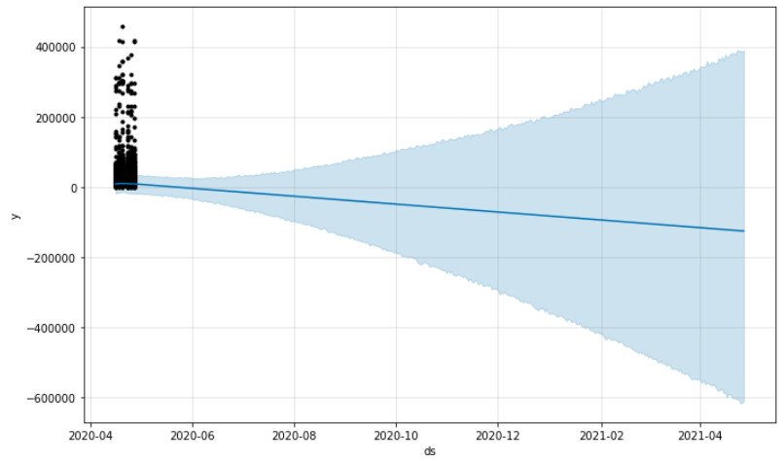
Fig 8.6: Prophet’s – Ease-My-Trip Dataset
Based on Prophet due to even shorter period it is more likely for large increase in variance as time
period increases.

Slide 59
SUMMARY
From the experiments conducted we see that:
Variance to be low when the estimation is for nearer date and more likely for larger variance to occur for farther the dates.
The Random Forest Regressor is found to be an optimal regressor when predicting flight fare.
The more Homogenous the data used the more likely it is to accurately predict flight flare.
The DB1B Dataset allowed for flight fare prediction at the market level accurately for over a year in advance but did not help in predicting the daily trends in flight fare.
The Machine Hack dataset and the Ease-My-Trip Dataset had shorter time periods; they came with accurate dates allowing for better predictions to be made.
The Ease-My-Trip Dataset came with an additional column ‘days left’ which accounted for the days left before flight which allowed for the daily variations in price to be accounted for.
The Observed trend is: The more homogenous the data and the more descriptive the features in the dataset are able to describe the flight scenario the better accurately the flight fare can be predicted.

Slide 60
References
Leo Breiman “Random Forests” 2001 Machine Learning, 45, 5-32, 2001 @ Kluwer Academic Publishers, Manufactured in The Netherlands
K. Tziridis, Th. Kalampokas, G. A. Papakostas and K. I. Diamantaras, "Airfare prices prediction using machine learning techniques," 2017 25th European Signal Processing Conference (EUSIPCO), Kos, 2017, pp. 1036-1039, doi: 10.23919/EUSIPCO.2017.8081365.
Viet Hoang Vu, Quang Tran Minh, Phu H Phung “An Airfare Prediction Model for Developing Markets” 2018 International Conference on Information Networking (ICOIN) 10.1109/ICOIN.2018.8343221
Supriya rajankar, Neha Sakharkar, Omprakash Rajankar “Predicting The Price Of A Flight Ticket With The Use Of machine Learning Algorithms” International Journal of Scientific &amp; Technology Research Volume 8, Issue 12, December 2019, ISSN 2277-8616
Juhar Ahmed Abdella, Nazar Zaki, Khaled Shuaib, Fahad Khan, Airline ticket price and demand prediction: A survey, Journal of King Saud University - Computer and Information Sciences, 2019, ISSN 1319-1578, https://doi.org/10.1016/j.jksuci.2019.02.001. (https://www.sciencedirect.com/science/article/pii/S131915781830884X)
Oren Etzioni and Rattapoom Tuchinda and Craig A. Knoblock and Alexander Yates “To buy or not to buy: mining airfare data to minimize ticket purchase price”, In Proceedings of KDD’03, 2003, ACM Press

Slide 61
7. Rian Mehta, Stephen Rice, John Deaton, Scott R. Winter, Creating a prediction model of passenger preference between low cost and legacy airlines, Transportation Research Interdisciplinary Perspectives, Volume 3, 2019, 100075, ISSN 2590-1982, https://doi.org/10.1016/j.trip.2019.100075. (https://www.sciencedirect.com/science/article/pii/S2590198219300740)
8. Li, Y., & Li, Z. (2018). Design and implementation of ticket price forecasting system. doi:10.1063/1.5039083
9. Wang, Tianyi & Pouyanfar, Samira & Tian, Haiman & Tao, Yudong & Alonso, Miguel & Luis, Steven & Chen, Shu-Ching. (2019). A Framework for Airfare Price Prediction: A Machine Learning Approach. 200-207. 10.1109/IRI.2019.00041.
10.T. Liu, J. Cao, Y. Tan and Q. Xiao, "ACER: An adaptive context-aware ensemble regression model for airfare price prediction," 2017 International Conference on Progress in Informatics and Computing (PIC), Nanjing, China, 2017, pp. 312-317, doi: 10.1109/PIC.2017.8359563.
11.PromptCloud (February 2021) EaseMyTrip Flight Fare Travel Listings, Version 1, Retrieved On May 2021 from https://www.kaggle.com/data/46091
12.U.S. Department of Transportation, Research and Innovative Technology Administration, Bureau of Transportation Statistics, Freight Transportation: Global Highlights, 2010 (Washington, DC: 2010)
13.Machine Hack (March 2019) Predict The Flight Ticket Price Hackathon, Retrieved on April 2021 from https://machinehack.com/hackathons/predict_the_flight_ticket_price_hackathon/data
14.https://www.oag.com/

Slide 62
THANK YOU

